Slide 1
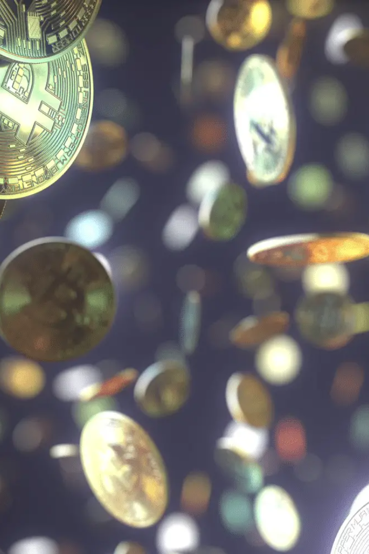
A Review of Non-fungible Tokens Applications in the Real-world and Metaverse
by Lavanya Moolya

Slide 2
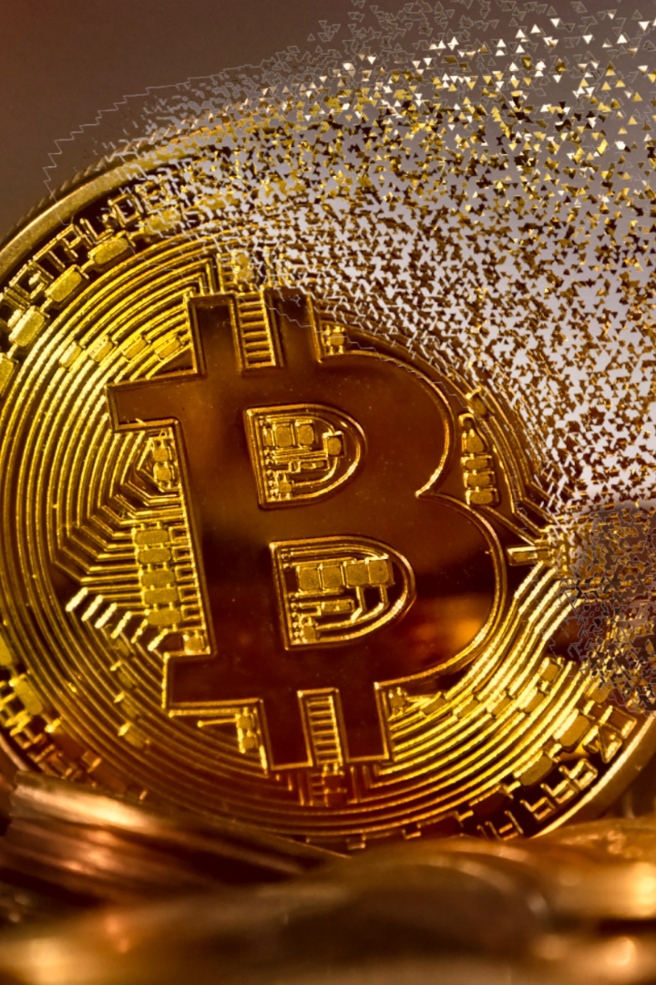
Literature Review:
The literature surrounding Non-fungible Tokens (NFTs) explores their applications in diverse real-world and metaverse contexts. Studies highlight their potential in art authentication, digital asset ownership, decentralized finance, and virtual property rights. Researchers emphasize the transformative impact of NFTs on industries and the challenges they pose in terms of scalability, sustainability, and regulatory frameworks.

Slide 3
Introduction
Non-Fungible Tokens (NFTs) were introduced in 2017 and the concept of the Metaverse in 1990s.The integration of NFTs into the Metaverse gained traction in recent years. NFTs represent ownership of virtual assets in Metaverse platforms, like virtual land, artwork, and goods.
NFTs represent digital assets that cannot be replicated or substituted, making them ideal for ownership verification, provenance tracking, and digital asset management.
They enable creators to tokenize their creations, allowing for secure and transparent ownership transfer, and potentially revolutionizing the way we buy, sell, and trade digital assets.
Additionally, NFTs have made a significant impact in the metaverse, a virtual space where individuals can interact, create, and transact.
In the metaverse, NFTs serve as unique digital goods that can be used, traded, and showcased within virtual worlds and online communities.

Slide 4

NFTs in the Metaverse
1
The Metaverse
The concept of the Metaverse involves a virtual internet-based world that allows users to interact and experience natural senses in a virtual environment.
2
Advantages of using NFTs in the Metaverse
NFTs enable ownership and verifiability in the metaverse by providing unique and verifiable proof of ownership for digital assets, introducing limited edition or unique NFTs, and utilizing blockchain technology for transparent and immutable ownership records

Slide 5
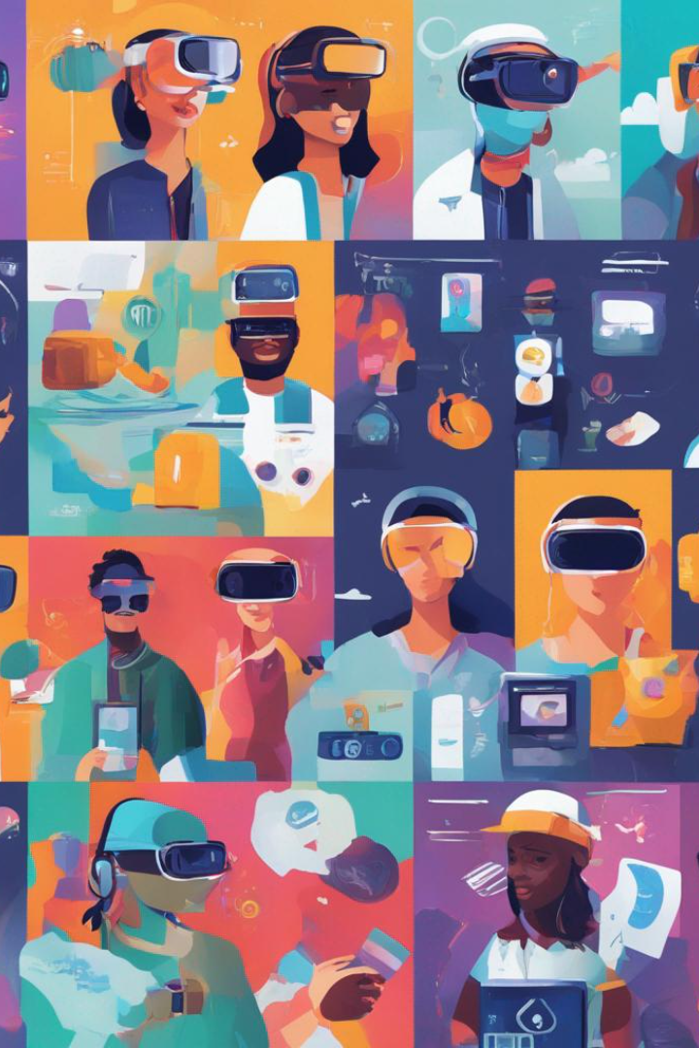
Current Applications
Virtual Education and Training
Virtual Sports and Gaming
Virtual Advertising and Sponsorships
Virtual Identity and Avatars
Gaming and Virtual Assets

Slide 6
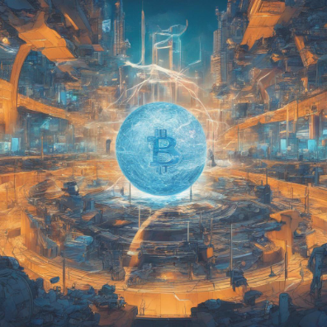
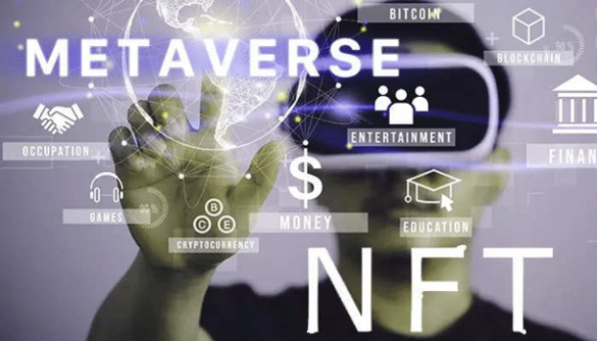
Challenges and Opportunities
Opportunities
Challenges
Virtual Identity and Personalization
Limited availability of relevant research papers
Digital Ownership and Authenticity
Virtual Economy and Virtual Goods
Diverse opinions and conflicting findings
New Revenue Streams
Difficulty in finding reliable sources
Keeping up with the constantly evolving research landscape

Slide 7
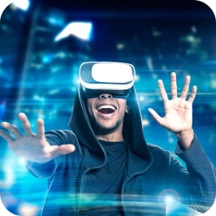
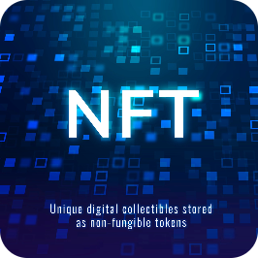

Future Scope
Integration with Virtual Reality:
Interoperability and Standards:
Integration with Internet of Things (IoT):
NFTs have the potential to enhance virtual reality experiences by allowing users to own, trade, and showcase virtual assets within immersive environments.
The development of interoperable standards for NFTs will enable seamless transfer and use across different platforms and ecosystems, fostering greater adoption and innovation.
NFTs can be integrated with IoT devices, enabling unique digital ownership and interactions with physical objects, leading to new possibilities in areas such as smart homes and connected devices.

Slide 8
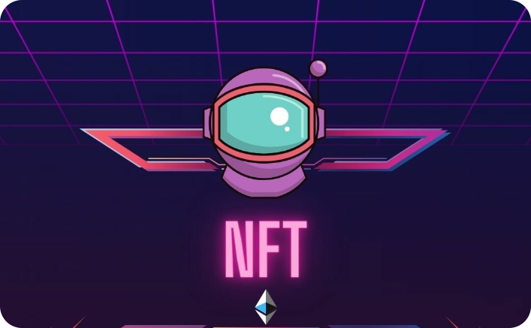
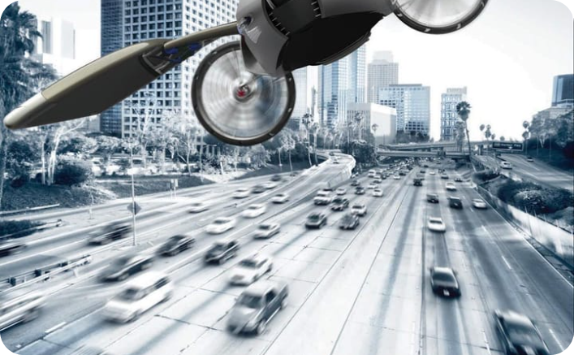
Conclusion
Implications and Potential
Embracing the Future
Reflect on the wider implications of NFTs in transforming ownership, value creation, and digital ecosystems, and envision the endless possibilities that lie ahead.
Encourage individuals and organizations to embrace the potential of NFTs and actively participate in shaping the future of digital ownership and collaboration.

Slide 9
References
1
A Review of Non-fungible Tokens Applications in the Real-world and Metaverse​
2
Non-fungible tokens, decentralized autonomous organizations, Web 3.0, and the metaverse in education: From university to metaversity
3
Semantics and Non-Fungible Tokens for Copyright Management on the Metaverse and Beyond

